Slide 1
IoE Chapter 6 Structural Health Monitoring using IoT
Dr. Vinayak A Bharadi

Slide 2
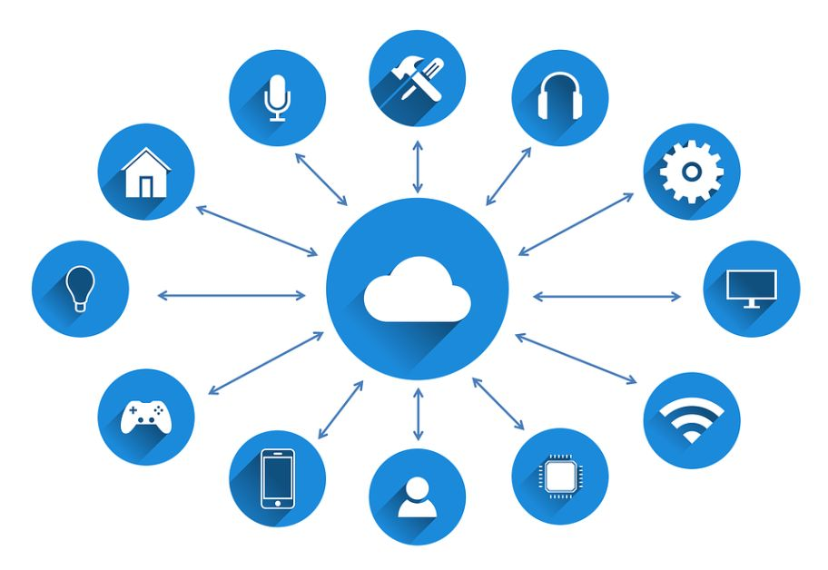

Slide 3
Maintenance is the paramount thing to focus, after constructing any structure. It is necessary to maintain the design strength of structure to increase life span.
Structural Health Monitoring (SHM) is a process, which used to find the safety of the structure. Internet of Things (IoT) is the emerging technology, using in SHM system.

Slide 4
SHM
Structural health monitoring is a continuous process of finding safety and soundness status of existing structures.
It also helps to find alternative solutions to ensure the safety of structures against early failures. This system use sensors to collect and analyze the various characteristics of the structure.
The collected data used to avoid any damage or failure of structure that may occur in its life span. This system used for mass structures such as bridges, skyscrapers, airports, dams, stadiums, tunnels and many others.
There are many techniques available to perform structural health monitoring such as,
Wired technique
Electro-Mechanical impedance method
Data fusion technique
Vibration control technique
Smart wireless technique
All these techniques are different from one another by cost, purpose, quality and technology factors. They also use different types of structural health monitoring devices to collect data. And use different software to analyze the collected data.

Slide 5
CASE STUDY
Stduents will prepare a Case study based on
Research Article | Volume 2017 |Article ID 6560797 | 10 pages | https://doi.org/10.1155/2017/6560797
Internet of Things (IoT) Platform for Structure Health Monitoring
Authors - Ahmed Abdelgawad and Kumar Yelamarthi

